Slide 1
METAL SHOP SAFETY
IF YOU CAN’T BE SAFE, YOU CAN’T BE HERE

Slide 2
THERE IS MACHINERY IN HERE THAT CAN
BREAK BONES
AND
CUT OFF FINGERS

Slide 3
BEHAVIOUR
NO HORSEPLAY
NO ROUGH-HOUSING
NO RUNNING
9

Slide 4
BEHAVIOUR
NO UNNECESSARY NOISE
We need to hear what’s going on
Machines: “good” sounds and “bad” sounds
PAY ATTENTION TO OTHERS
They might not pay attention to you
9

Slide 5
ATTIRE
NO JEWELRY
Rings, bracelets, necklaces,
ties, etc.
NO LOOSE CLOTHING
Hoodie strings, baggy clothes, earphones, etc
9

Slide 6
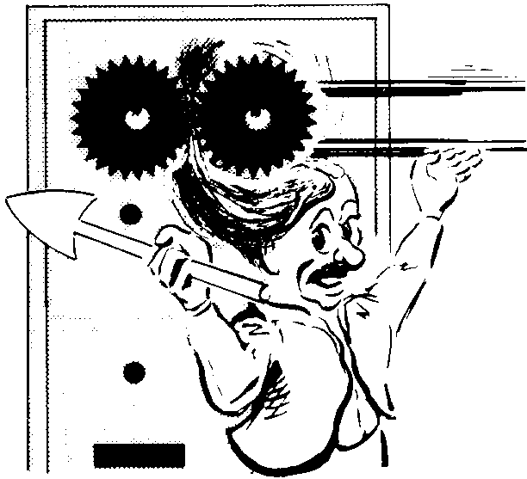
ATTIRE
NO LONG HAIR
Tie it back
WEAR NATURAL FIBER
CLOTHING
Cotton, leather, etc.
9

Slide 7
PROCEDURAL
WORK CLEAN & HELP CLEAN
A clean shop is a safe shop
NO DISTRACTIONS
iPod, daydreaming, under influence of…?
9

Slide 8
PROCEDURAL
ASK FOR HELP or DEMOS
I love the “teaching” part of my job
LOCKOUT or UNPLUG the machine when making adjustments
No accidental “turn on”
9

Slide 9
PROCEDURAL
STAND AN ARM’S LENGTH AWAY
If the operator could punch you, you’re too close, give them room
KEEP FINGERS A HAND WIDTH’S AWAY FROM CUTTERS
“No Finger Zone”
9

Slide 10
SAFETY EQUIPMENT
THE #1 MOST IMPORTANT:
EYE PROTECTION
Cutting, striking, shaping or
removing metal
Goggles: Minimum
Face Shield: BEST
9

Slide 11
YOU NEED EYE PROTECTION
…If it plugs in
…If it turns on
…If it removes material
BEST PRACTICE:
ALWAYS wear eye protection
9

Slide 12
SAFETY EQUIPMENT
HAND PROTECTION
PROTECT against burns or cuts
DO NOT get them wet! (that wrecks them)
DO NOT pick up hot metal! (that wrecks them)
9

Slide 13
DO NOT PICK UP
HOT METAL
WITH GLOVES!
>USE PLIERS<

Slide 14
SAFETY EQUIPMENT
EAR PROTECTION
Near loud noises
If you have to raise your voice,
you need ear protection
9

Slide 15
TOOLS

Slide 16
RULER
Precision MEASURING instrument
For scribing STRAIGHT lines
Millimetres and Inches (KNOW the difference!)
9

Slide 17
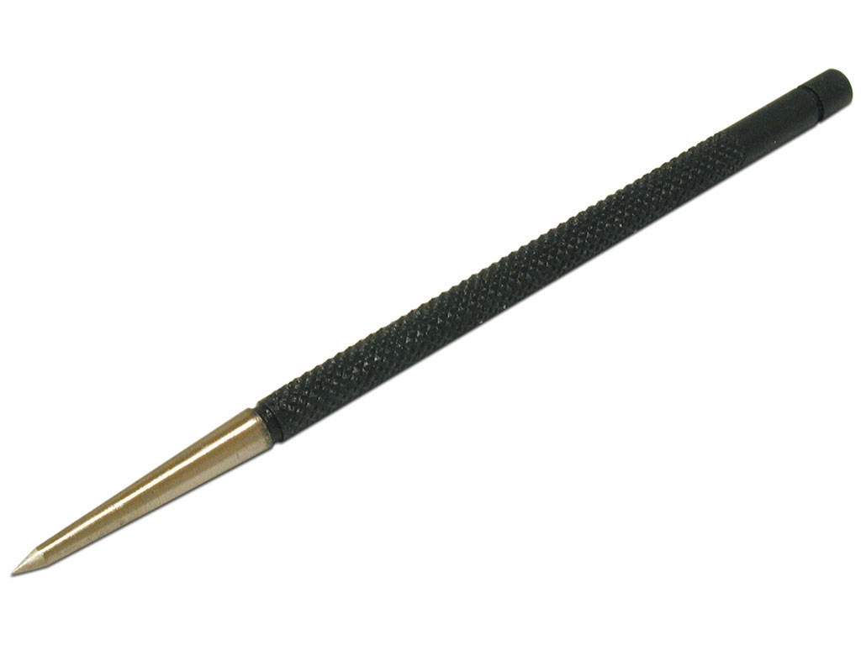
SCRIBER
For PRECISE MARKING of material
SHARP 135° point
Pencil & ink rub off
FELT PEN is NOT accurate enough for metal.
9

Slide 18
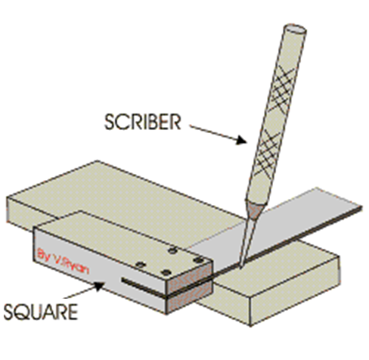
SQUARE
For marking or checking a SQUARE EDGE (90°)

Slide 19
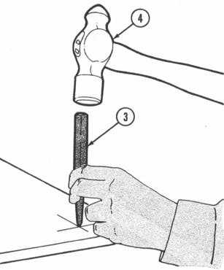
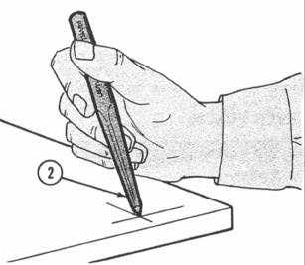
CENTER PUNCH
For MARKING HOLES for drilling
Use with a HAMMER (wear eye protection)
90° point
9

Slide 20
AVIATION SNIPS
For cutting SHEET METAL only! (it shears)
Serrated teeth
Green Cuts Left
Yellow Cuts Straight
Red Cuts Right
9

Slide 21
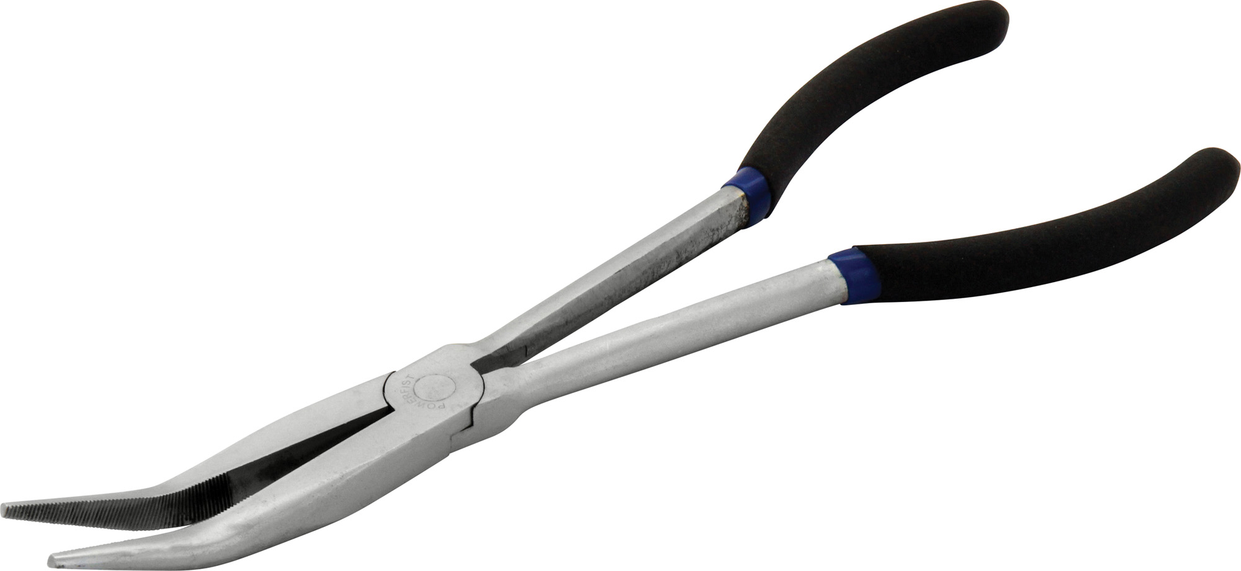
45° BENT NOSE PLIERS
AWESOME for Art Metal and Jewelry
9

Slide 22
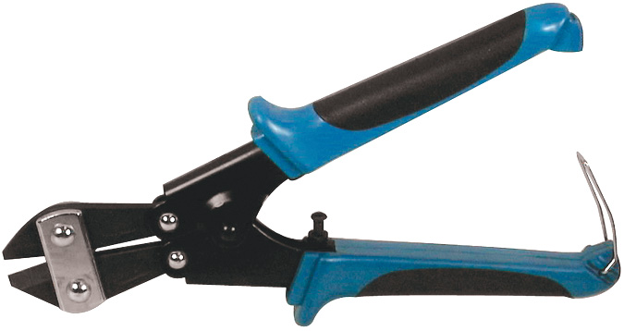
MINI BOLT CUTTERS
AWESOME for cutting round!
9

Slide 23
SIDE CUTTERS
AKA “Diagonal Pliers”
For cutting ROUND material (it pinches)

Slide 24
SLIP JOINT PLIERS
AWESOME for picking up HOT and WELDED METAL! (Do not use gloves!!)
NOT for nuts and bolts!!!
Adjustable for two sizes of gripping
9

Slide 25
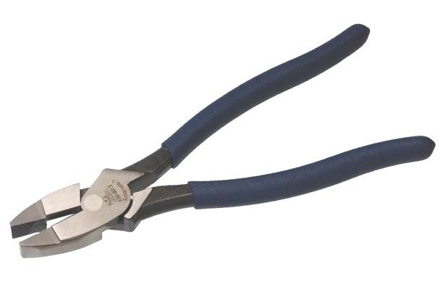
LINEMAN’S PLIERS

Slide 26
NEEDLE NOSE PLIERS

Slide 27
MIG PLIERS (WELPERS)
AWESOME!
Used with MIG Welder
Grip
Cut wire
Clean nozzle

Slide 28
WRENCH
AWESOME for NUTS and BOLTS
If possible, always use the BOX end

Slide 29
ADJUSTABLE WRENCH
Useful, but can RUIN nuts and bolts if not adjusted tightly
NOT a recommended tool
9

Slide 30
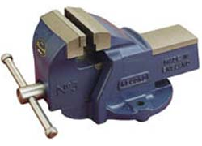
VISE
For CLAMPING your project
JAWS will damage your project
Use SOFT metal to protect YOUR project
9

Slide 31
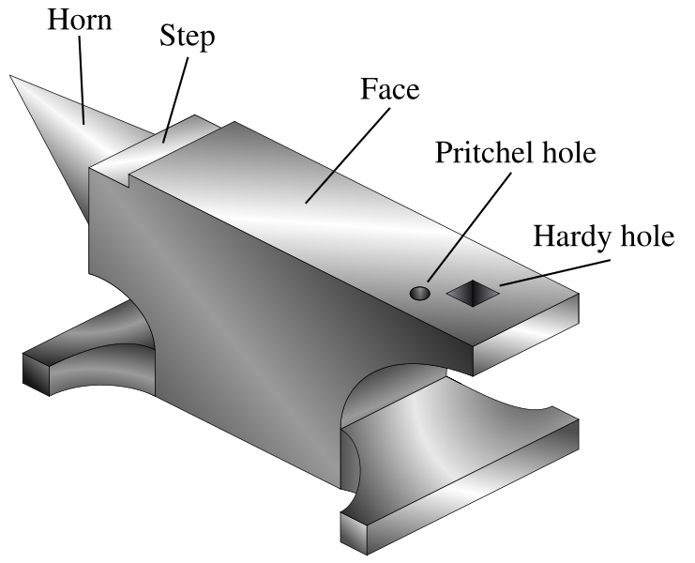
ANVIL
For SUPPORTING or SHAPING metal
Best for Center-Punching
9

Slide 32
BALL PEEN HAMMER
For SHAPING and STRIKING
WEAR EYE PROTECTION
Hardened steel (DO NOT STRIKE TWO HAMMERS TOGETHER)
9

Slide 33
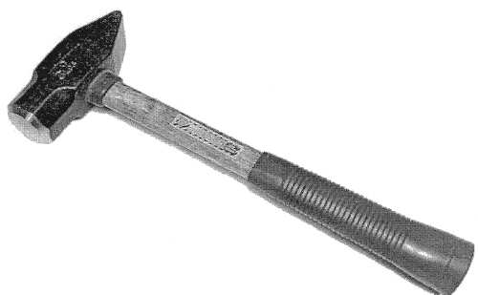
CROSS PEEN HAMMER
Used for striking and shaping
Pointy end used to widen metal in Blacksmithing
WEAR EYE PROTECTION
9

Slide 34
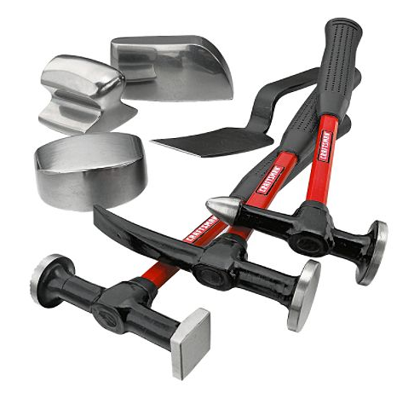
BODY HAMMER
Very light weight
For flattening thin sheet metal
Delicate hits
Always support metal with a dolly
WEAR EYE PROTECTION
9

Slide 35
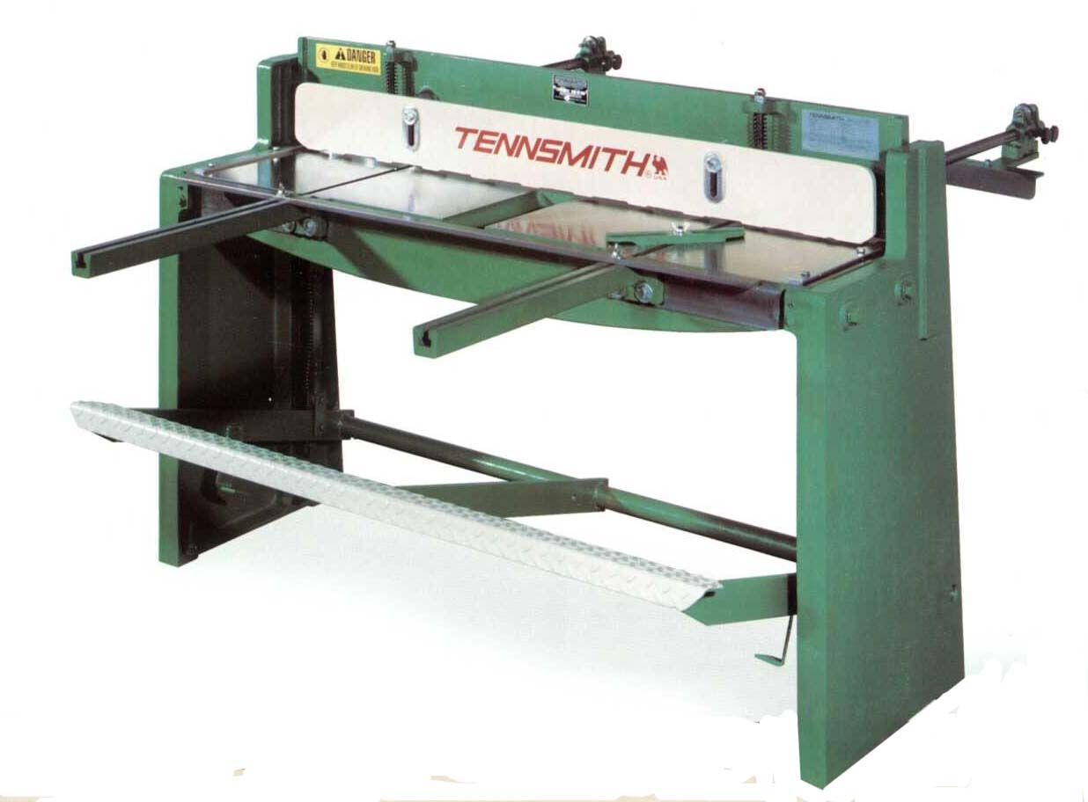
FOOT SHEAR
For cutting SHEET METAL ONLY
NO ROUND!!!
9

Slide 36
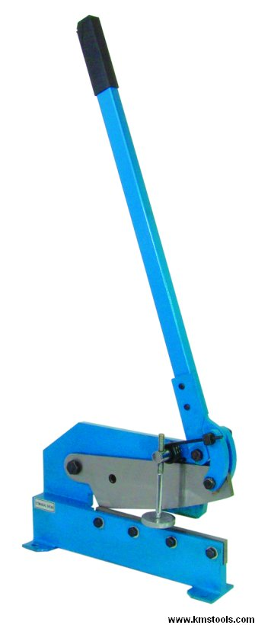
HAND SHEAR
For cutting SHEET METAL ONLY
Doesn’t do “curves” well
NO ROUND!!!
Notes:
https://www.youtube.com/watch?v=eBbZK03MUVw

Slide 37
THROATLESS SHEAR
For cutting SHEET METAL ONLY in curves
Doesn’t do “straight” well
NO ROUND!!!
Notes:
https://www.youtube.com/watch?v=4mBtKpUwN9k

Slide 38
HACKSAW
Cuts metal
Keep AT LEAST 3 teeth touching metal at all times
BABY the blade!
CUT SLOW and use PRESSURE
FAST = HEAT = DULL BLADE!
TEETH point away from the handle
9

Slide 39
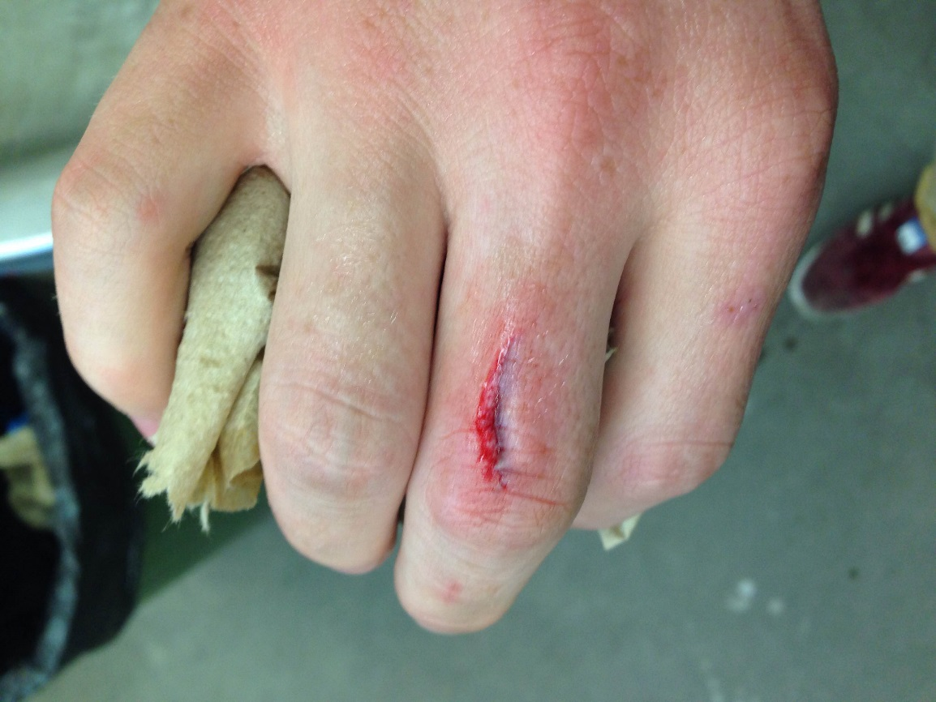
DON’T PUNCH THE VISE
“Listen” to the sound of the cut
The pitch changes as you get closer to finishing
DO NOT punch the vise
9

Slide 40
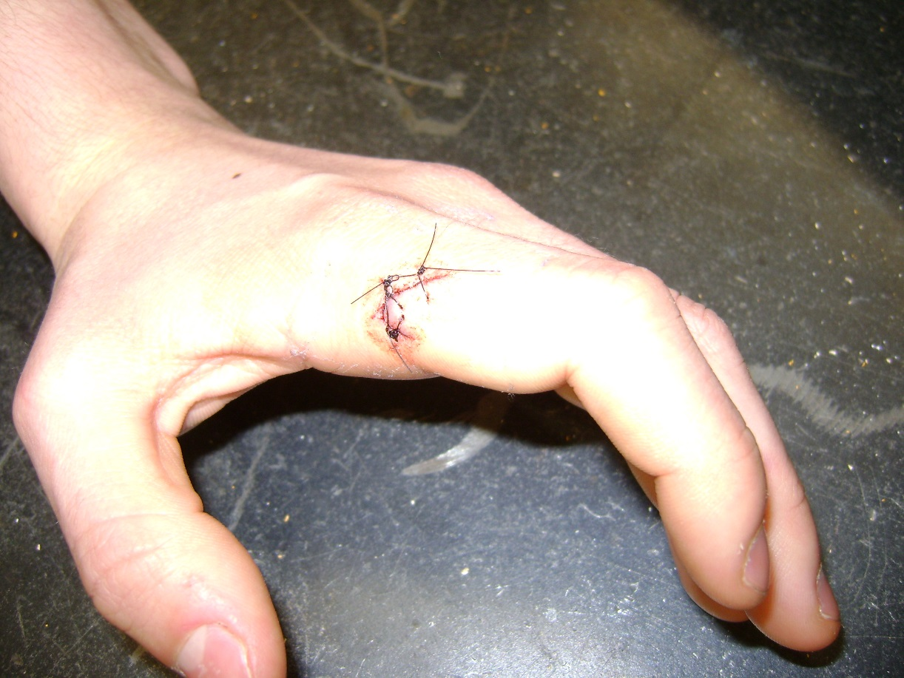
HACKSAW
A Hacksaw is a ONE-MAN tool
“How do I stop this from bleeding?”
9

Slide 41
INTERMISSION
Hey: Mr. Wellwood: Do something else for a bit
- lots of love, Mr. Wellwood

Slide 42
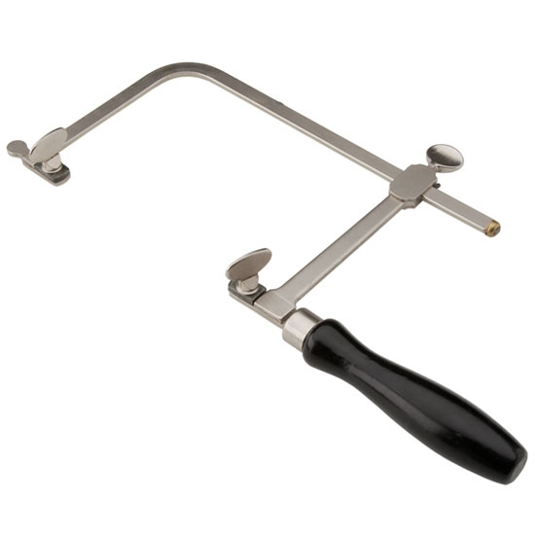
JEWELRY SAW
AWESOME for tiny, delicate cutting
BABY the blade!
CUT SLOW and use PRESSURE
FAST = HEAT = DULL BLADE!
TEETH point TOWARDS the handle
WEAR EYE PROTECTION
9

Slide 43
FILE
For SHAPING metal
EASILY dulled, chipped or broken!
Be GENTLE!!!
DO NOT bang together or against anything
Works on PUSH stroke only
9

Slide 44
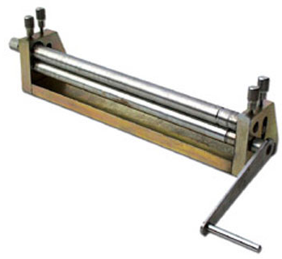
SLIP ROLLERS
For curving sheet metal ONLY
BABY the rollers
Make sure rollers are parallel or you will make a cone shape

Slide 45
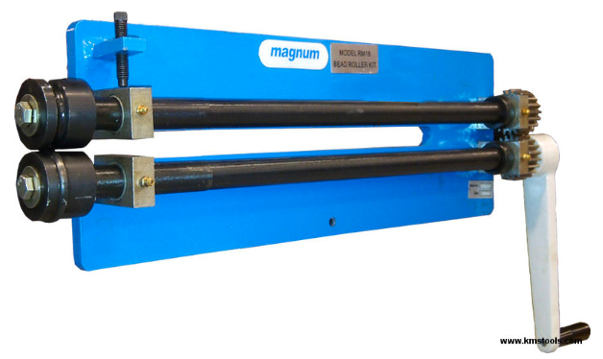
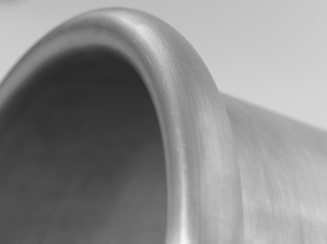
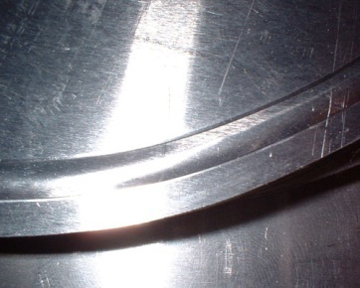
BEAD ROLLER
For rolling raised beads into sheet metal
For THIN sheet metal
Specific dies for specific purposes
Notes:
https://www.youtube.com/watch?v=V4STgBsMam8

Slide 46
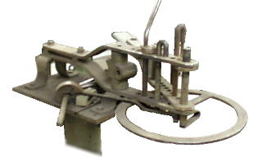
HOSSFELD BENDER
AWESOME for bending
Can bend just about anything
VERY cool machine

Slide 47
FOR ALL POWER TOOLS
Stay at least AN ARM’S LENGTH AWAY from the operator!
Give them an “out” if something goes wrong

Slide 48
HAND DRILL & DRILL PRESS
Makes holes
Wear EYE PROTECTION
All material must be CLAMPED DOWN
9

Slide 49
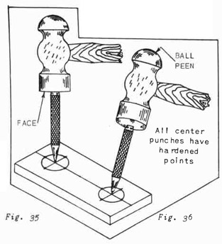
HAND DRILL & DRILL PRESS
All holes must be CENTER-PUNCHED
Any hole bigger than 1/4” must be PRE-DRILLED With a smaller drill bit
9

Slide 50
DEPTH STOP controls how DEEP you drill!
(Super handy)
9

Slide 51
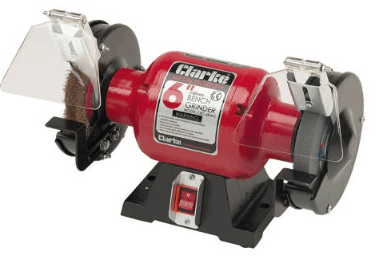
BENCH GRINDER
GRINDING – removes metal
Wear EYE PROTECTION
Wear EAR PROTECTION
For STEEL ONLY
Check: magnet sticks to steel
Non-steel metals (softer metals) PLUG the stone
PLUGGED stones go not grind any more
PLUGGED stones overheat and fail
FAILED stones can injure you
9

Slide 52
BENCH GRINDER
Tool Rest = 1/8” (3mm) away from stone
Stones may explode - Stand to one side when starting
Grind on the FACE of the stone only
9

Slide 53
WIRE WHEEL
CLEANS metal
Wear EYE PROTECTION
Wire Wheel will SHRED your skin
https://www.youtube.com/watch?v=8jr-cE-l59k
9
Notes:
https://www.youtube.com/watch?v=8jr-cE-l59k

Slide 54
WIRE WHEEL
Wire wheel on the BOTTOM of the wheel
Hold material tight enough that you have it, but loose enough that if the machine wants to eat your project, IT can have it.
NOT recommend to wear GLOVES
There is a risk: gloves could get caught in the machine and cause a bigger accident
9

Slide 55
BUFFING WHEEL
For ART METAL CLASS only
Wear EYE PROTECTION
Polish on BOTTOM of wheel
(Top spins towards you)
CAUTION: Polishing gets HOT!
NO CHAINS!
9

Slide 56
ANGLE GRINDER
For grinding STEEL ONLY
Grind OUTSIDE
Watch where the sparks go
Sparks hurt people
Sparks ruin paint and glass
Wear EYE PROTECTION
Wear EAR PROTECTION
Wear GLOVES

Slide 57
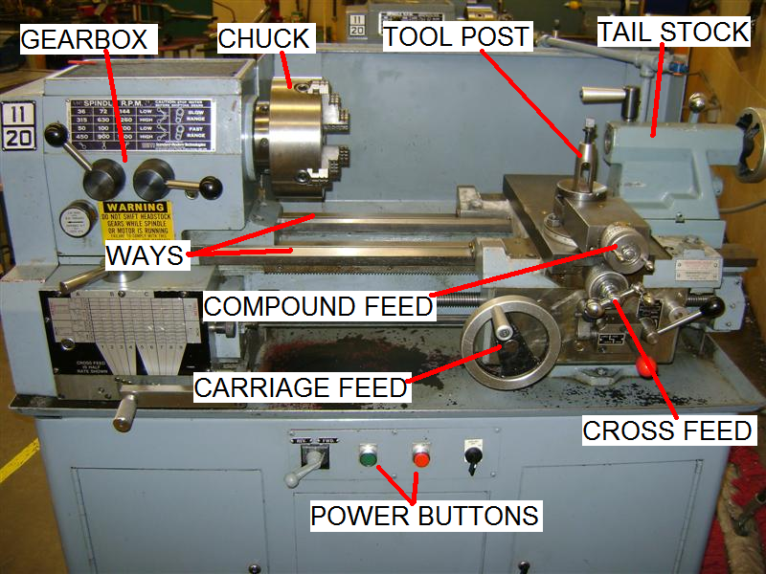
LATHE
9

Slide 58
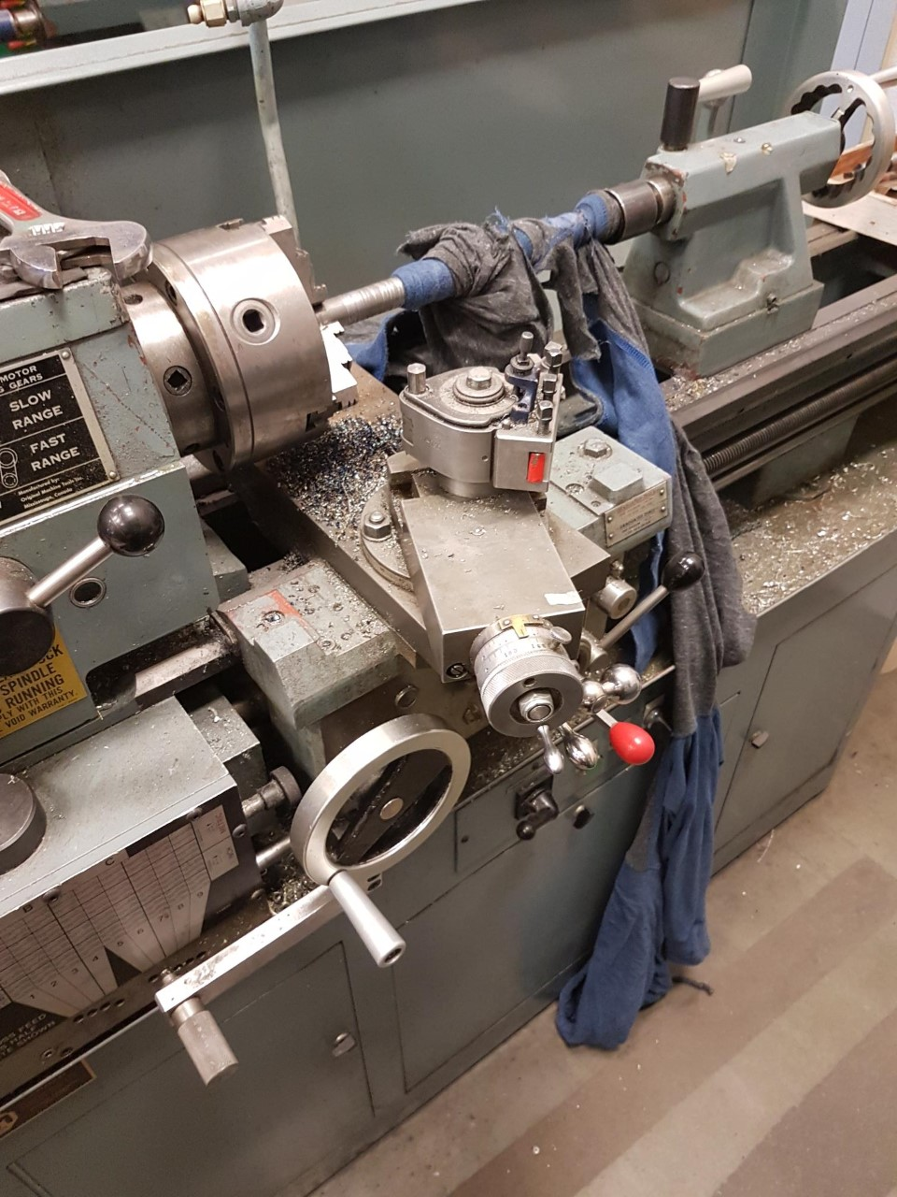
LATHE
Makes things ROUND
Wear EYE PROTECTION
Keep hands, arms, sleeves, hoodie strings THE HELL AWAY from the spinning chuck
It WILL mess you up
9
Notes:
Kid in Vernon. Lathe RIPPED his shirt off his body, and was pulling him in by the collar. His face was AT his work in SECONDS by the time the teacher got the power shut off.

Slide 59
9

Slide 60
LATHE
NEVER leave the CHUCK KEY in the CHUCK
NEVER means NEVER
Spin the chuck BY HAND before you turn it on
9

Slide 61
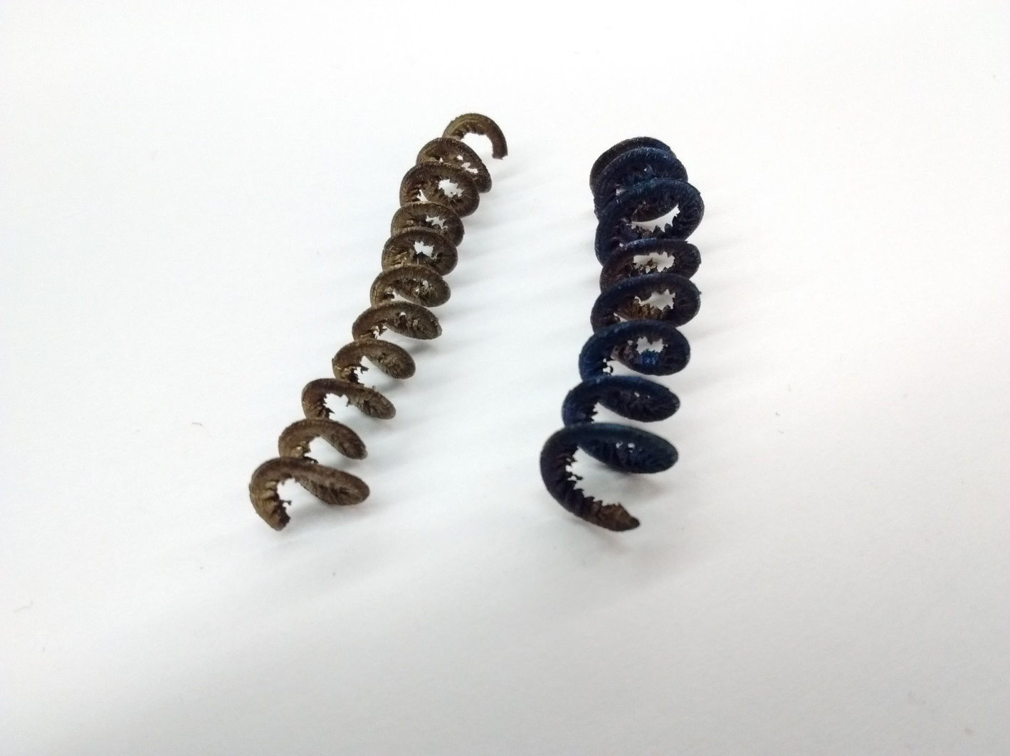
LATHE
Be nice to the cutter – take light cuts
Watch chip colour:
Gold is good
Blue is bad
9

Slide 62
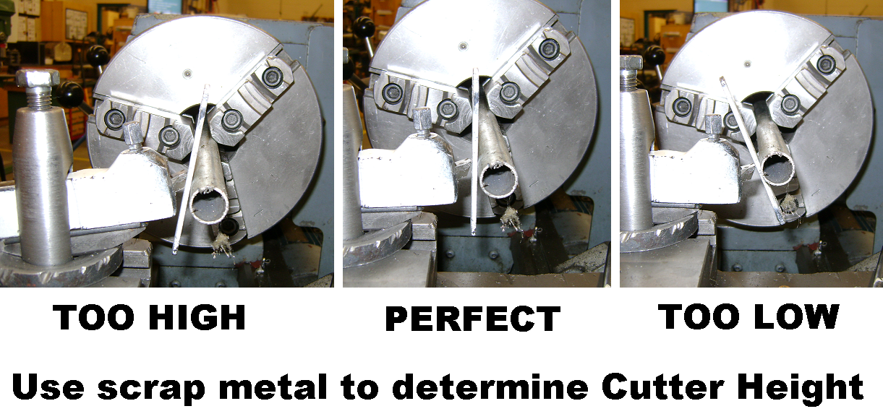
LATHE
Cutter should be ~90° to direction of travel
Cutting tip should be same height as project center
9

Slide 63
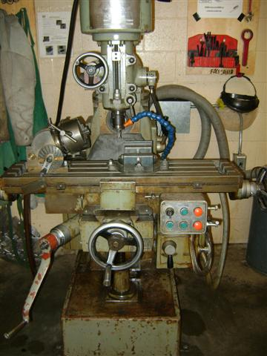
MILLING MACHINE
Makes things FLAT
Wear EYE PROTECTION
9

Slide 64
MILLING MACHINE
Material MUST be WELL CLAMPED
Keep hands, arms, sleeves, hoodie strings THE HELL AWAY from the spinning cutter
It WILL mess you up
9

Slide 65
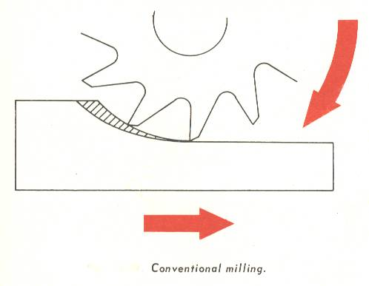
MILLING MACHINE
Cut AGAINST the rotation of the cutter
Be nice to the cutter – take light cuts (Chip Colour!)
9

Slide 66
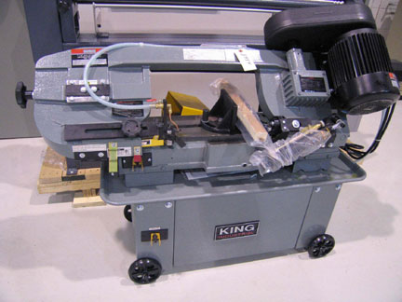
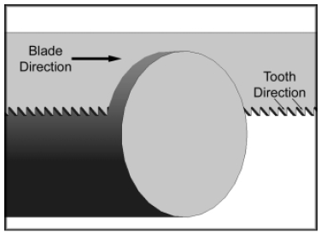
HORIZONTAL BANDSAW
For cutting reasonably to excessively thick metal
NO THIN METAL

Slide 67
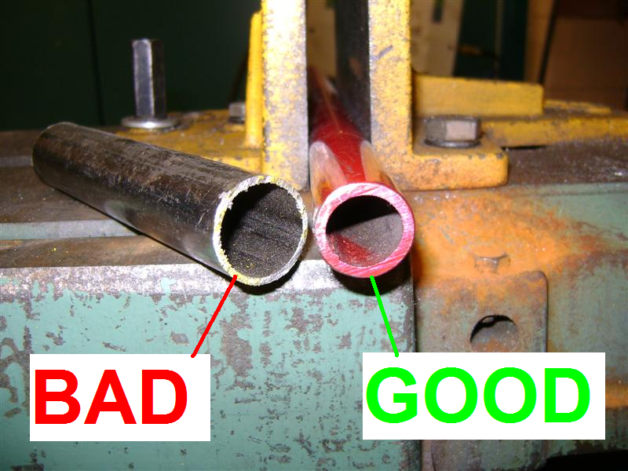
HORIZONTAL BANDSAW
At least 3 adjacent teeth in contact at ALL TIMES

Slide 68
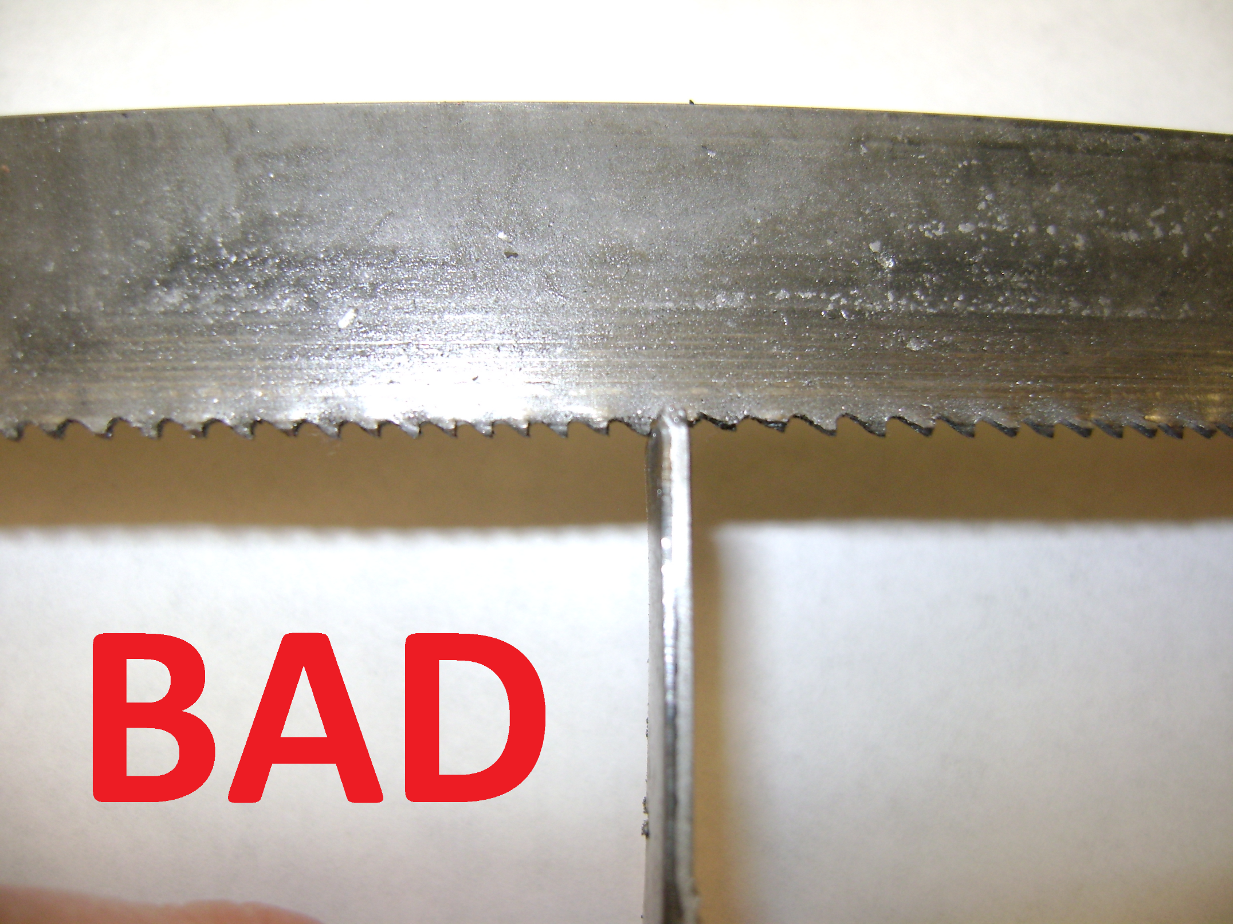

Slide 69
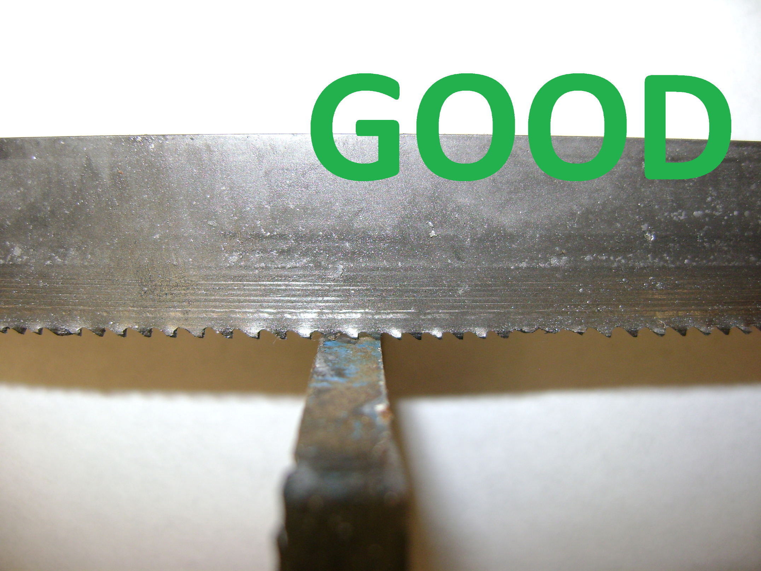

Slide 70
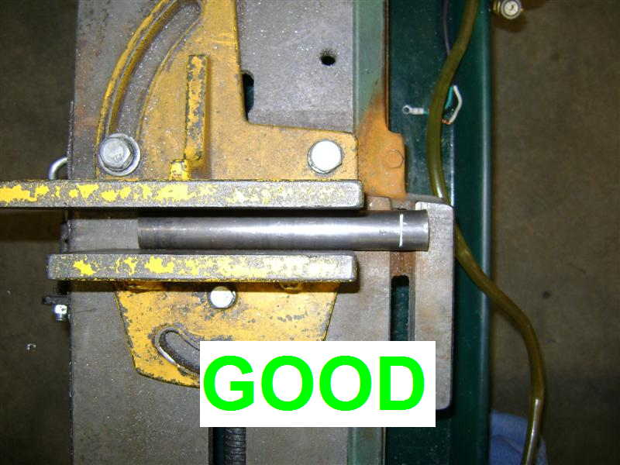
HOIZONTAL BANDSAW
Hold metal NO SHORTER THAN THE CLAMP

Slide 71
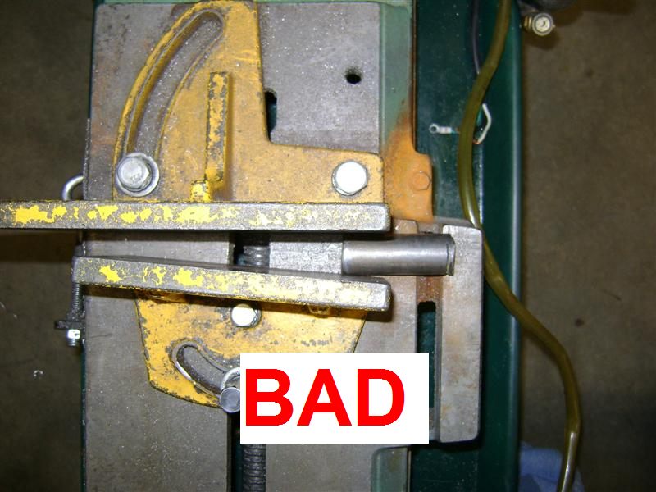
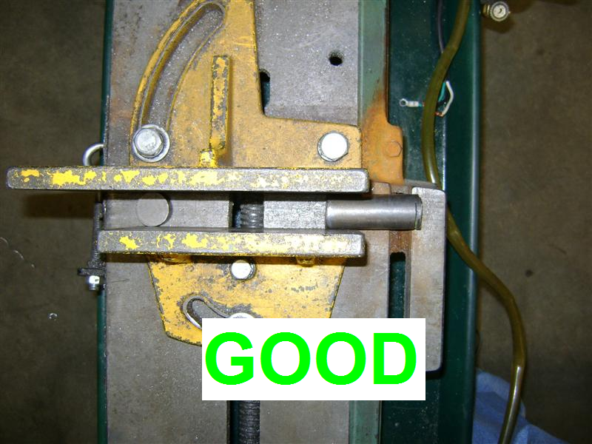
Breaks Blade
SAVES BLADE

Slide 72
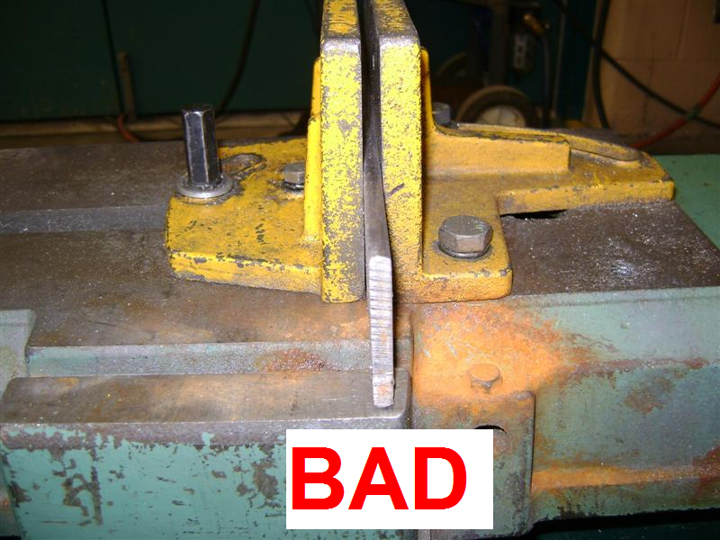
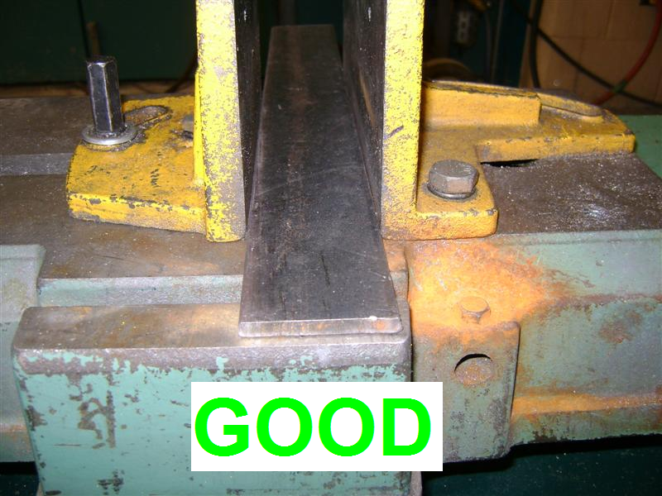
< Hard on Teeth
EASY ON TEETH >

Slide 73
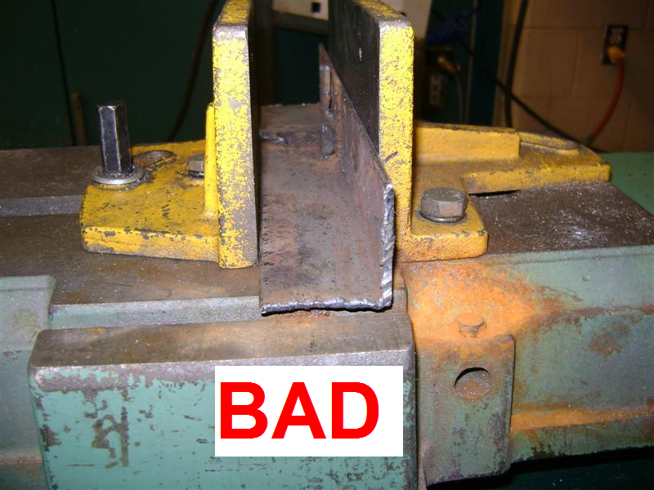
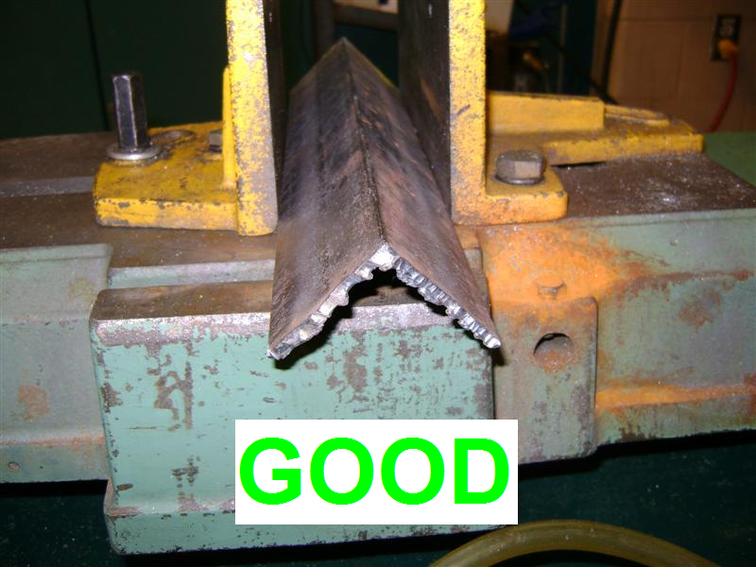
< Hard on Teeth
Easy on Teeth >

Slide 74
BLADE DEATH

Slide 75
CHOP SAW
AWESOME for TUBING!
SUCKS at SOLID
EYE PROTECTION (FACE SHIELD)
EAR PROTECTION
CLAMP TIGHT
NO STEEP ANGLES!

Slide 76
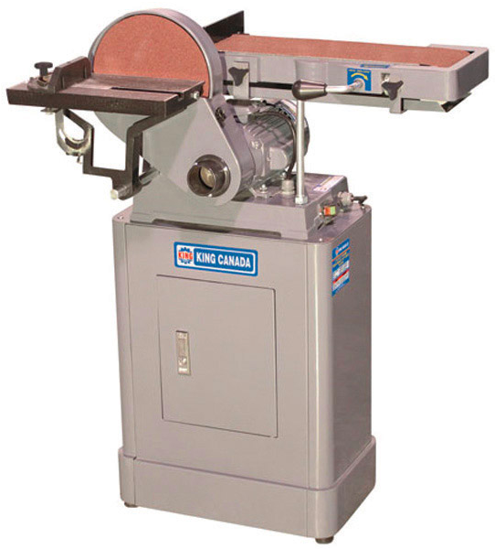
BELT SANDER
For finishing metal surfaces
EYE PROTECTION
Watch your fingers
Sand on DOWN side of disk rotation

Slide 77
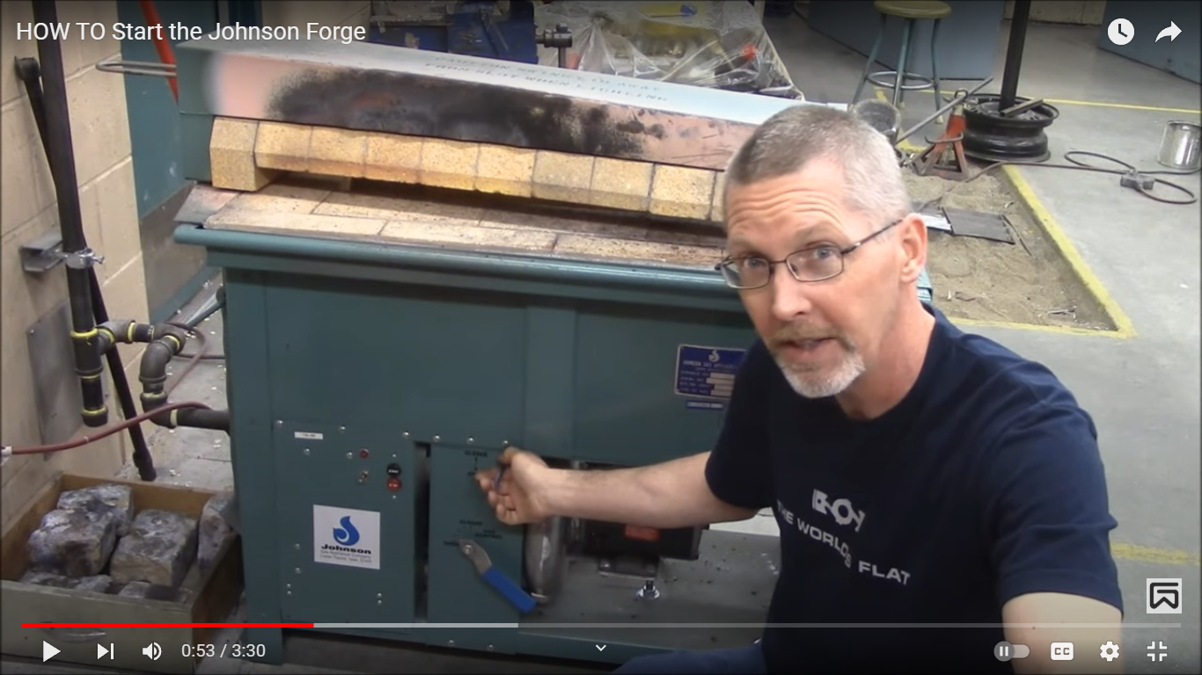
BLACKSMITH FORGE
HOT!
FACE SHIELD!
EAR PROTECTION!
LEATHER GLOVES!
LEATHER JACKET!
BRAINS!!
There’s a story behind that….
9

Slide 78
DO NOT PICK UP
HOT METAL
WITH GLOVES!
>USE TONGS<

Slide 79
9

