Slide 1
FIND A SEAT
FACE THE BOARD
(Who cannot follow instruction on the first day?!)

Slide 2
TALKING POINTS
Bell Schedule
Washrooms
Traffic Flow
Change Rooms
Verification Forms
Course Changes
Busses
Lockers
Smoking/Vaping
Cell Phones
I Fµ&!~9 HATE THEM
Garbage & Litter
Hallway Noise
Attendance
Substances
Neighbours
Open Campus
Parking
Code of Conduct

Slide 3
Welcome to My Class
Mr. Wellwood

Slide 4
MECHANICS
Engine and Engine Support Systems
Importance of, and how to maintain your vehicle
Knowledge for purchasing a used car
Make informed decisions when taking your car in for service
Well prepared for a career or hobby in the world of automotive should you so desire

Slide 5
WORKPLACE MATH
The Math that is used in every workplace, trade, industry, career, manufacturing facility, whatever
My hobby is radical vehicle modifications – this IS the math I use!
It will not prepare you for University Math
And that is OK
Most Trades Programs want to see at least 60% in any kind of Math

Slide 6
BEING OPEN AND HONEST
I love teaching
I don’t always love people

Slide 7
BEING OPEN AND HONEST
I have VERY high expectations
I have a VERY strong Work Ethic

Slide 8
BEING OPEN AND HONEST
Apparently I am a little “Intense”
Apparently I can be a bit “abrasive”

Slide 9
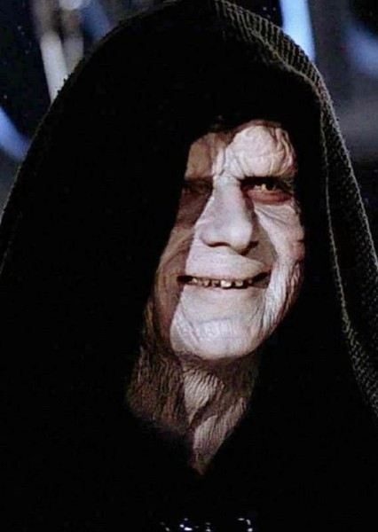
BEING OPEN AND HONEST
I am high-functioning Autistic
“Absolutes” (yes, no)
I am a very rare
Personality Type
Notes:
I am VERY particular in HOW things are done
I tend to work in “Absolutes” (yes/no, on/off)
I won’t get all your jokes (you won’t get mine)
Introvert, Intuitive, Thinking, Judging
1% of the population
All TV and Movie Villains

Slide 10
THINGS I SUCK AT:
Compassion
Empathy
Simple Math
Remembering names
Sports

Slide 11
THINGS THAT PISS ME OFF:
Your Phone
Cannot follow instruction
Cannot retain information
Wasting material
Wasting time
Your Phone

Slide 12
I don’t believe in “Brain Breaks”
I don’t believe in “Loser Laps”
I believe your Cell Phone is making you dumber
I believe in “PRODUCT” over “PROCESS”
I don’t believe in “Everyone Gets a Ribbon“
No, not everybody gets an “A” here

Slide 13
MY PURPOSE, THE REASON I AM HERE, THE REASON I BECAME A TEACHER:
MAKE YOU EMPLOYABLE
SPARK A PASSION/INTEREST
Notes:
Everything I talk about is going to be chock full of “Employability Skills.” Becoming employable is more important to me than your grades.

Slide 14
TO BE EMPLOYABLE
BE PRODUCTIVE
ALWAYS “DO”
Waiting does not pay the bills!
BE RESOURCEFUL
FIND SOLUTIONS TO YOUR PROBLEMS
Notes:
NO SUCH THING AS “WAITING”
THERE IS ALWAYS SOMETHING TO DO

Slide 15
TO BE EMPLOYABLE
BE RESPECTFUL
EVERYBODY DESERVES IT
NOT EVERYBODY EARNS IT
WORK SAFE
NOBODY NEEDS TO GET HURT HERE

Slide 16
RESPECT
Everyone deserves to be treated with respect. You, Me, even little Billy.
You get a LOT further in life if you treat others with respect.
Politeness is my Kryptonite; I have a really hard time saying “no” to polite.
Notes:
Some of you need to learn this. Some of you will never learn this – those are the assholes in your neighbourhood.

Slide 17
RESPECT
I purpose to treat you with respect
I strive to be CONSISTENT and FAIR
I am not always “NICE”
I will address you by your LAST NAME, as an adult
You will use your LAST NAME on your work

Slide 18
ATTEND
This is a “hands-on” course; you cannot succeed if you are not here. You can’t get paid if you ain’t there.
You are expected to be ON TIME, and attend class for the DURATION of class.
Your Letter Grade will indirectly reflect this.
Notes:
Taking Math online has a VERY HIGH “drop out” rate.

Slide 19
ABSENCES
JUST LIKE BEING YOUR EMPLOYER:
YOU CALL or EMAIL me in ADVANCE
I will EXCUSE the “shop time”
2 “Sick Days“ per Term only
I will NOT excuse “assignments”
Notes:
Not for Math

Slide 20
ABSENCES
There will be NO “make up time” outside of class
PARENTS are still to call in your absence to the school
Notes:
Not for Math

Slide 21
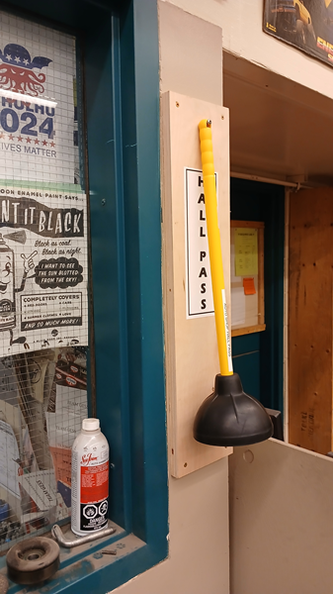
LEAVING THE CLASSROOM
ALWAYS ask
I’ll almost always say “yes”
NEVER for food
NEVER for the foods room
HALL PASS -->
HURRY back!
Notes:
Were you in the foods class when I tore a strip off the kids for this?

Slide 22
TRY
Don’t be a Quitter; Quitters never prosper.
Give me your effort; I will give you my help.
I will NEVER give you a task that you cannot do.

Slide 23
Whether you think
“YOU CAN”
Or…
Whether you think
“YOU CAN NOT”
YOU ARE RIGHT!

Slide 24

Notes:
There are things you are awesome at. There are things you suck at. And it will be different things for everybody. Someone else will be awesome at what you suck at, but you are going to be awesome at something they suck at – PLAY to your strengths, DELEGATE your weaknesses. NOBODY is awesome at everything

Slide 25
PRODUCE
If you don’t do the work, you don’t get paid
Pure and simple
This is LIFE

Slide 26
FOLLOW INSTRUCTION
ALL of us have to do what we are told, even ME
If you won’t follow instruction, You won’t stay employed
Notes:
2025 – 40% of my students had the comment “Cannot follow instruction”

Slide 27
MAKE YOURSELF EMPLOYABLE
WORK HABITS are FAR more important than your GRADES.
WORK HABITS are WAY more important than your GRADES.
WORK HABITS are MUCH more important than your GRADES.
Notes:
And our lovely School System no longer collects “Work habit” marks.

Slide 28
BELLS
START the class
END the class
BREAKS
10:18 - 10:27
1:49 – 1:57
Notes:
Regardless of what your other teachers do, this is what I do.

Slide 29
RIGHT HERE IN LAKE COUNTRY
There are companies HERE where you get FIRED if you are on your phone when you are supposed to be working!

Slide 30
MY SON’S CONSTRUCTION JOBSITE
You get FIRED if you are on your phone when you are supposed to be working!
You get FIRED if you have ear buds in when you are supposed to be working!

Slide 31
COURSE OUTLINE
Course Outline
How to get ahold of me
Course Content
Marks: assignments & day sheets
Contracts

Slide 32
COURSE OUTLINE
BRING
ALL: Pen, Paper, Binder
SHOP: Shop Coat and Long Pants, or Cover-Alls, closed toe shoes
DO NOT BRING
Food or Drink
I hate your phone!
Assembly/Fire/Earthquake/Lockdown

Slide 33
CALCULATORS NOT PHONES
I will be loaning you a CALCULATOR
NOT YOUR PHONE
You will be using one of my CALCULATORS
NOT YOUR PHONE
You will ONLY use a CALCULATOR
NOT YOUR PHONE
Notes:
For MATH

Slide 34
DAY SHEETS
YOU fill out the date every day
YOU mark yourself in the BOX with the DOT
PRODUCTIVE (100%=3, 90%-=2, 80%=1, <80%=0)
PREPARED (on time, have all your stuff = 1)
WORK SAFE, CLEAN UP (=1)
Notes:
Not for Math

Slide 35
DAY SHEETS
WHEN YOU SAY “I’m Helping”
WHAT I HEAR: “I was standing around doing nothing”
“WAITING?” There is no such thing as “waiting”
“Waiting” does not pay the bills!
Notes:
Not for Math

Slide 36
OH, YOU’RE ALWAYS LATE?
You are clearly “not prepared,” so you lose one mark for the day
You can’t possibly work 100%, so you lose AT LEAST one mark for the day
So now the best you can hope for is 3/5
That’s now 60%, and a “C” not an “A”
YOU JUST DROPPED THREE LETTER GRADES!!
BE ON TIME! BE PRODUCTIVE!

Slide 37
DAY SHEETS
YOU: DESCRIBE what you did in class
YOU: PLAN what you are going to do NEXT DAY
MISS A CLASS? YOU PHONE/EMAIL in ADVANCE!
If I’m your boss, I need to know you’re not coming in
Notes:
Were you PRODUCTIVE? WHY SHOULD I PAY YOU?
HAVE a PLAN for next day THIS IS FOR YOU TO USE YOUR TIME WISELY!

Slide 38
NOTICE!
At the top of the day sheet:
Disappear without permission?
Lose your marks for the day
Get kicked out?
Lose your marks for the day
I EXPECT YOU TO BE IN CLASS
FOR THE DURATION OF CLASS
Notes:
Not for Math

Slide 39
How can I do awesome in your class, Mr.W?
Be ON TIME
Be PREPARED for class
Be RESPECTFUL
Ask PERMISSION to leave class
Be PRODUCTIVE
Follow INSTRUCTION
Retain INFORMATION
WORK SAFE
CLEAN UP

Slide 40
Is it possible to fail your class, Mr.W?
Heck yeah!
But it’s up to YOU!
And I believe in you!

